Slide 1
Building a Culture of Quality,
Real World Examples
Josh Meier
Architect, Quality Engineering
@moshjeier

Slide 2





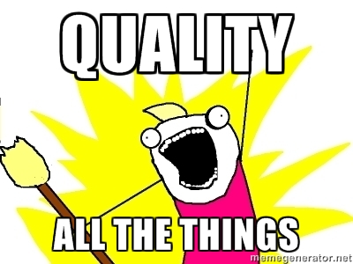
Who am I?

Slide 3

http://images.clipartpanda.com/stop-sign-clipart-z7TaM5XiA.png
Notes:
Before I talk about building a culture of quality I though it would be good to talk about what culture actually means

Slide 4

What is culture?
http://freebeer.fscons.org/freebeerlogo.png

Slide 6
Okay, really, what is culture?
Environment
Behaviors
The way we do things around here
Values & attitudes
Fundamental assumptions and beliefs

Slide 7
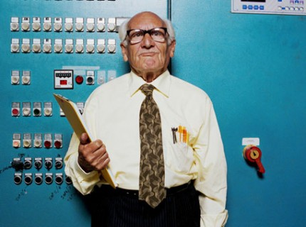
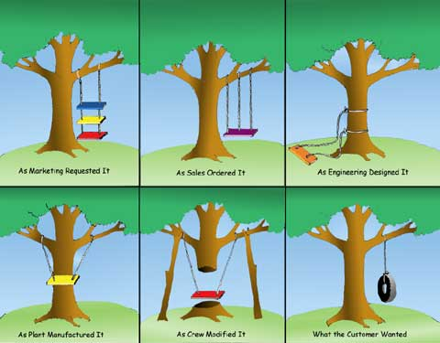
Engineering
Employee
http://blog.thingsdesigner.com/uploads/id/treeswing.jpg, http://www.timsackett.com/wp-content/uploads/2011/12/older-worker-430x320.jpg

Slide 8
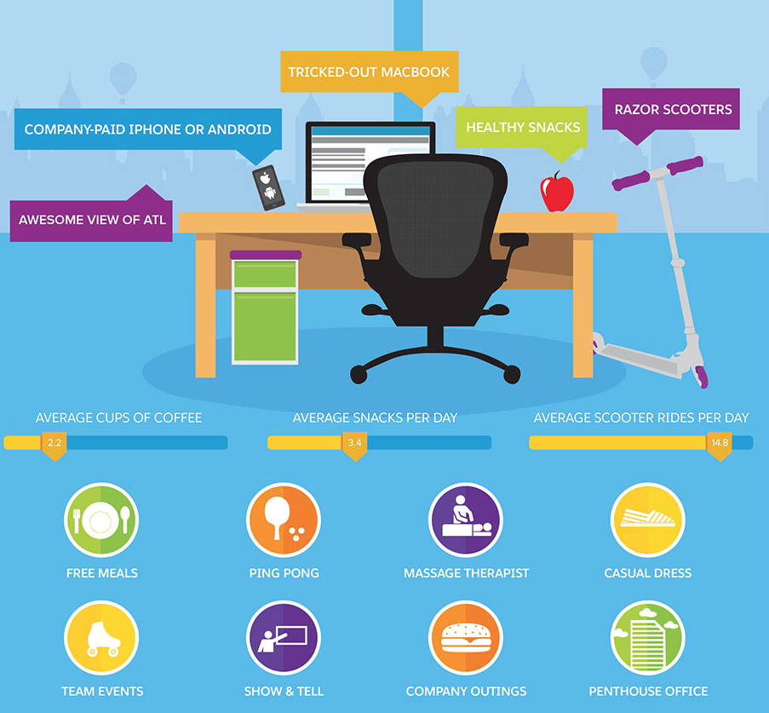

Slide 9
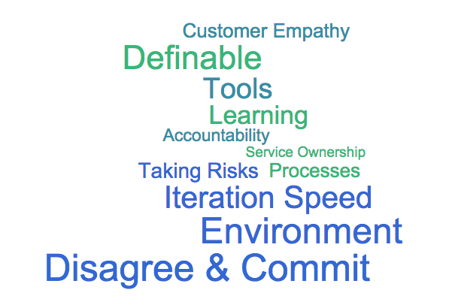

Slide 10
"A ship in port is safe but that's not what ships are built for"
grace hopper.
Notes:
Not interested in the final battle to get into production. They don't understand that risk happens, they just don't want to ship.
knowing how it was designed, tested and made ready for release is enough to diagnose any problems

Slide 11
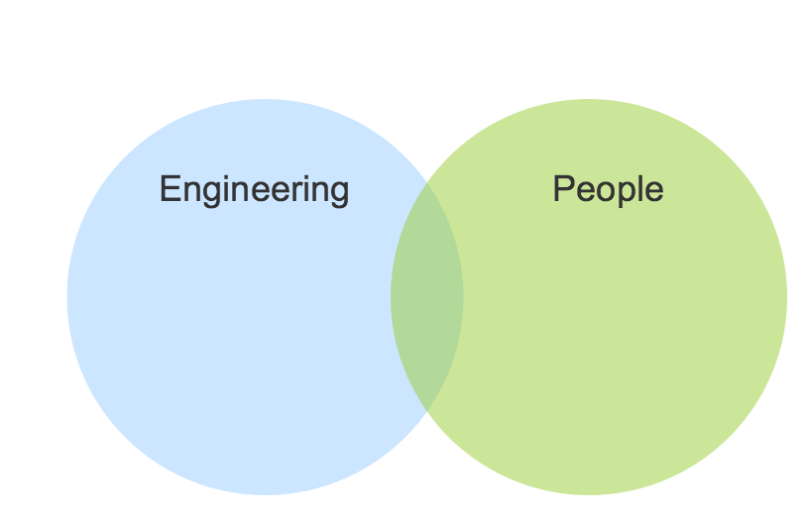
Notes:
Both are important, both are hard to get right, and sometimes it takes a larger investment in one while you course correct another

Slide 12
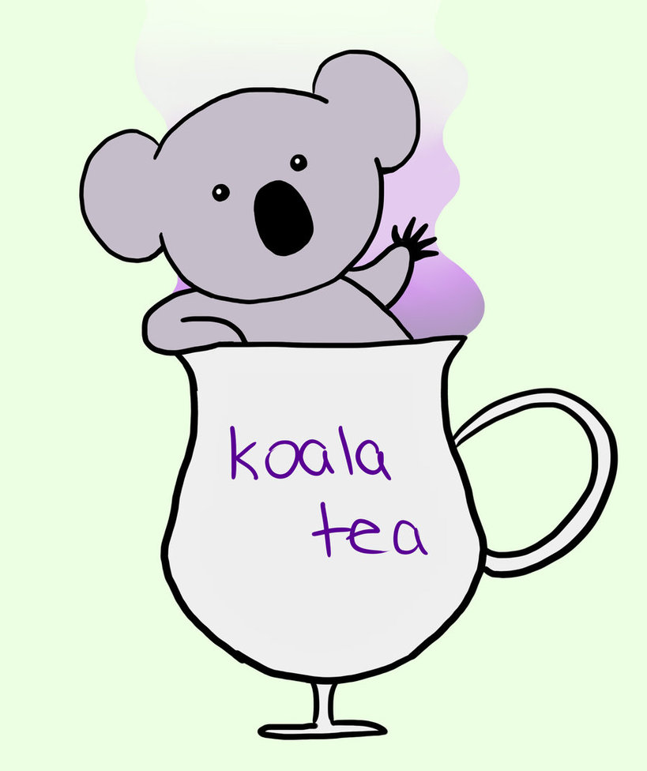
What is Quality?
?

Slide 13
What is Quality?
A system can be considered quality when it meets the needs of the user, is intuitive and provides a better experience than the previous solution.

Slide 14
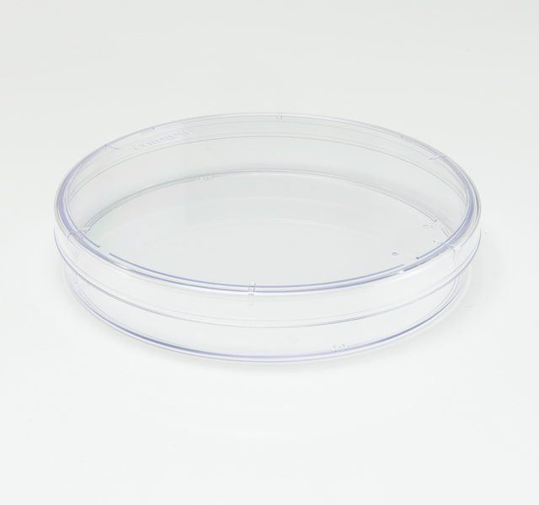
Culture + Quality = ???
http://pre07.deviantart.net/fc46/th/pre/i/2012/050/f/9/koala_tea_by_demonchasing-d4q9i56.jpg
http://www.truelinelab.com/sites/www.truelinelab.com/files/product-images/culture-dish1.jpg
Notes:
So we’ve established a baseline for both culture & quality, how do they go together?

Slide 15
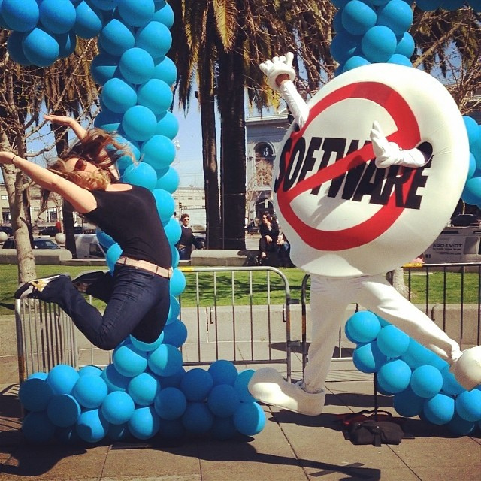
Culture + Quality = Happy Customers
Notes:
Culture+Quality=Happy Customers
Get people to care about the quality of the product and give them the tools to measure/act/improve quality.

Slide 16
Building the culture
Have tools that provide visibility into how well the software is running in production
Engineers understand how their software runs in production
Have engineers participate in customer cases/trouble tickets
Have engineers buddy with frontline support
Pager duty *gasp*

Slide 17
Building the culture
Encourage writing testable/checkable code
Test non-happy-path scenarios
Testers partner with devs, testers shared test cases, pair testing/programming
Testers participate in code reviews
Colocation
Shared accountability

Slide 18
2006-2012

Slide 19
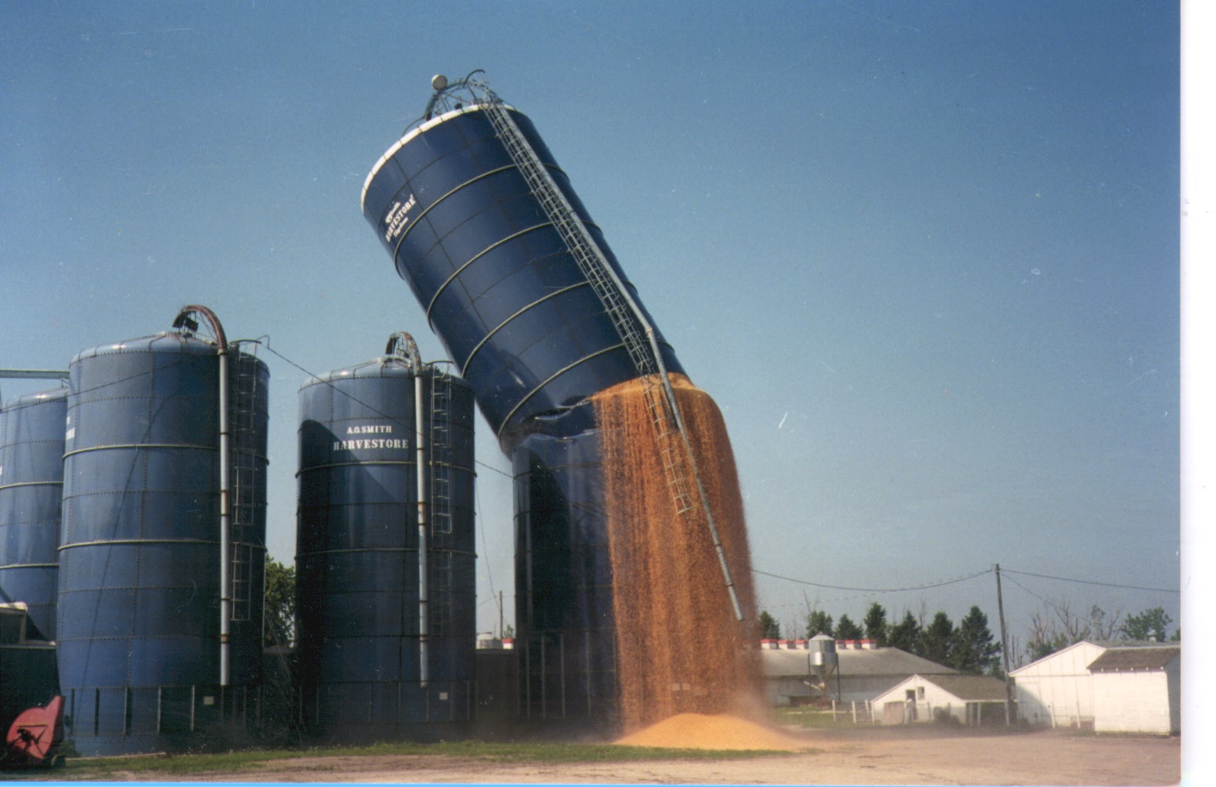
https://jenike.com/files/2012/10/BlueSiloCollapsing-41.jpg
Notes:
Built on a foundation of dev > testers
Very “throw over the wall” culture
Devs wrote unit tests but didn’t talk with testers
Bugs would go back and forth between test & dev with “works on my machine” and “I can still reproduce”
Devs and testers were treated as different class citizens
Testers were on a separate team

Slide 20
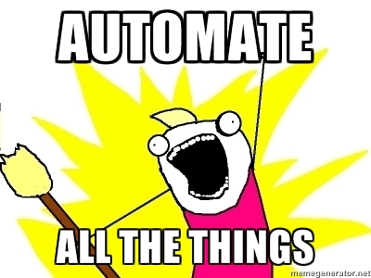
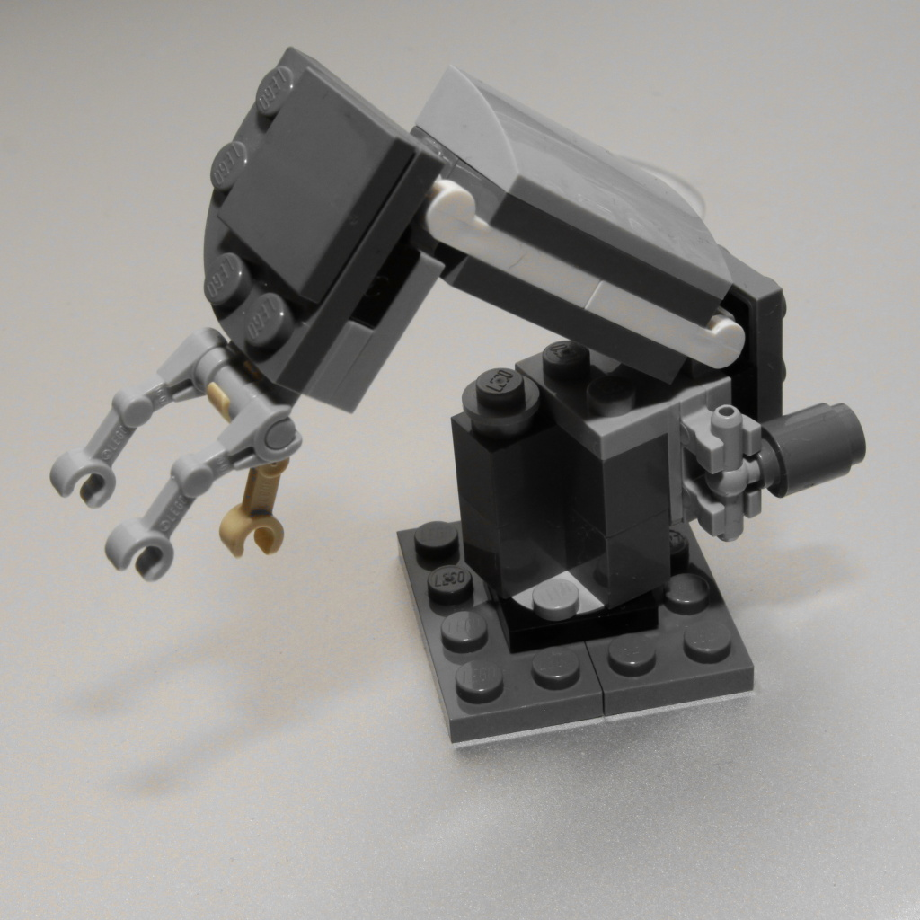
https://farm3.staticflickr.com/2640/3959355664_22383aeaf8_o_d.jpg, http://ddf912383141a8d7bbe4-e053e711fc85de3290f121ef0f0e3a1f.r87.cf1.rackcdn.com/automate-all-the-things.jpg
Notes:
Testing was very manual/human, very little automation.
Automation that did exist was very heavily UI automation
Believed that automation could almost entirely replace humans
No stable, representative test environment
SOA, wire-based communications across services
Semi-frequent releases (~2 weeks)

Slide 21

https://pixabay.com/en/evolution-monkey-man-transition-296400/

Slide 22
Filed bug reports that contained the potential issue/fix in them

Slide 23
Began attending scrum meetings as an observer

Slide 24
Started building relationships with developers
Talked about technology in general
Talked about specific technical problems the team was having
Talked about the culture of the company
Talked about sports

Slide 25
Sat with developers as they were coding
Mostly just watched
Asked a few questions
Pointed out potential defects when I saw them
“What if the user does this?”
“What happens in situation <x>?”
“Should we do a null check here?”
“How are we going to test this?”

Slide 26
Asked for early access to feature code, often on the developer's desktop

Slide 27
Starting providing test cases based on specs

Slide 28
Began participating in code reviews

Slide 29
Worked with other members of the QA team to start doing the same thing with the teams they supported.

Slide 30
Held brown bags to showcase how our teams were working together, the benefits we had received, and advocating for other teams to try it out

Slide 31

https://upload.wikimedia.org/wikipedia/commons/c/cb/3D_Judges_Gavel.jpg

Slide 32
For the teams that adopted the new quality culture we found:
Releases were more stable and less of a fire drill to get out the door
Morale was higher across the board
Testers were treated as equals and their input was valued
Turnover decreased

Slide 33
2012-Current

Slide 34
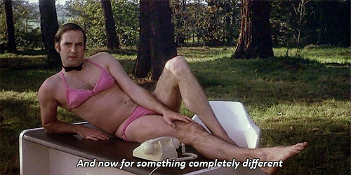
https://31.media.tumblr.com/1007eda95260423e86925ee79276dd6d/tumblr_ns1f7gq9qt1s1mluxo1_500.gif
Notes:
Totally different experience, a focus on quality was front and center. dev == testers
QEs (testers) focused on automation almost exclusively
Large, centralized bug bashes
Human testing deprioritized for automated checking
QEs were all hired with certain technical levels (aka, they could all read/write code)
No stable, representative test environment
Monolithic Application
Custom customer code
3 major releases/year
QEs/Devs treated as same class citizens

Slide 35
https://pixabay.com/en/evolution-monkey-man-transition-296400/

Slide 36
Reintroduce exploratory testing/human testing element

Slide 37
Focus on making the system more testable

Slide 38
Execute the customers automated tests for them

Slide 39
Know what other teams are working on, remove silos

Slide 40
Recognized need for more frequent releases, balance with customers desire for less change
Starting to make the required changes to support faster releases
Implementing better better release processes
Educating customers

Slide 41
https://upload.wikimedia.org/wikipedia/commons/c/cb/3D_Judges_Gavel.jpg

Slide 42
Work in progress
Teams that embrace knowledge sharing and ET see better results with releases
The desire to produce a high quality product is present, sometimes the means to do it aren’t
Moving from Enterprise model to Cloud/services model

Slide 43

http://3.bp.blogspot.com/-FQVB50BUMb8/UX_RmE1YG3I/AAAAAAAAqbc/IcqlhgDn_N8/s1600/id-rather-hunting-zombies-battaile-politics-1367305637.jpg

